Slide 1







MANJRASOFT ANEKA CLOUD AND APPLIANCES
www.manjrasoft.com
Presented By:
VARUN KUMAR R

Slide 2




WHAT IS ANEKA?
Aneka is a software platform developed by Manjrasoft that provides a framework for building and running applications on private, public, or hybrid clouds by efficiently utilizing distributed computing resources.
Aneka is a cloud application platform developed by Manjrasoft (Australia)
It supports parallel and distributed computing
Acts as middleware between applications and cloud resources
Helps in development, deployment, and management of applications
Aneka was introduced in 2007 by Manjrasoft

Slide 3

WHY ANEKA? WHY DO WE NEED ANEKA?
Without Aneka
With Aneka (by Manjrasoft)
Complex development of distributed/parallel applications
Easy development using ready APIs
Manual resource management (no centralized control)
Centralized monitoring & management tools
Slow deployment and scaling
Fast deployment and scalability
Difficult to maintain performance (QoS issues)
Efficient resource utilization with better performance

Slide 4
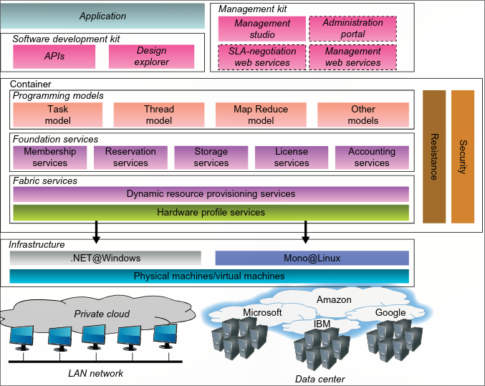
Architecture and components of Aneka.

Slide 5
Aneka Capabilities
1. Build
Provides SDK (APIs + tools) for fast application development
Can create private, public, and hybrid clouds
Uses resources from enterprise systems and cloud platforms like Amazon EC2
2. Accelerate
Supports multiple OS (Windows, Linux/UNIX)
Uses local machines efficiently for better performance
If resources are not enough → adds extra resources from cloud (like EC2)
Helps meet deadlines (QoS requirements)
3. Manage
Provides GUI and APIs for monitoring and control
Helps in managing cloud infrastructure easily
Includes accounting and resource allocation system
Supports scalability based on SLA/QoS

Slide 6
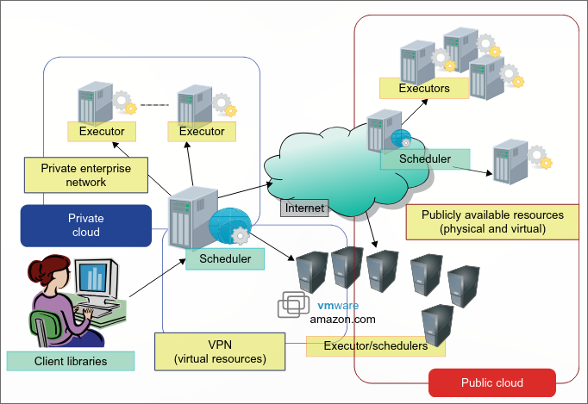
Aneka using private cloud resources along with dynamically leased public cloud resources

Slide 7
Aneka Architecture
Uses multiple machines (physical + virtual) connected together
Each machine runs an Aneka Container (manages services)
Uses PAL (Platform Abstraction Layer) to handle different OS
Three Main Services
Fabric Services → Manage basic resources & hardware
Application Services → Run and manage applications
Foundation Services → Handle storage, billing, monitoring

Slide 8
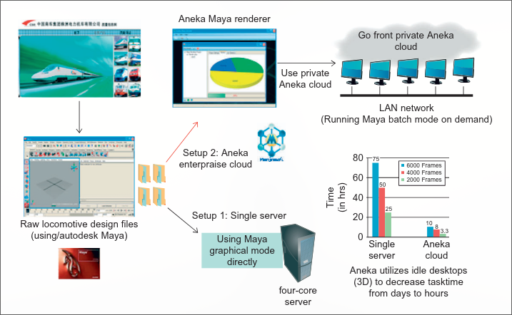
Aneka Application of Maya Rendering Case Study
Aneka Maya Rendering Case Study shows how Manjrasoft’s Aneka platform was used to speed up 3D rendering (using Autodesk Maya) by distributing the work across multiple computers in a cloud
GoFront Group used Aneka for high-speed 3D rendering
Earlier: 3 days to render 2000+ frames on a single server
Solution: Created enterprise cloud using multiple PCs (20 nodes)
Used Aneka Design Explorer to divide rendering tasks
Each system processed different frames in parallel
Result: Rendering time reduced from 3 days → 3 hours
Benefit: Faster design improvement and higher productivity

Slide 9
Virtual Appliances
Virtual Appliances are pre-configured virtual machines that include everything needed (OS, software, libraries) so applications can run instantly without setup in cloud environments like Aneka.
Built using virtualization tools like VirtualBox, KVM, VMware Player
Contains complete software stack (OS + apps + configs)
Works out-of-the-box (no manual installation needed)
Reduces dependency on system environment
Improves flexibility, security, and isolation

Slide 10
THANK YOU

